Slide 1
TEAM MEMBERS
NAME | ROLL NUMBER
ANKIT ACHARYA | NPI000140
ANMOL MALLA | NPI000141
JITEN CHAPAGAIN | NPI000150
PUKAR NEPALI | NPI000165
RANGIN BASNET | NPI000167
SATINDRA BAHADUR KHADKA | NPI000178

Slide 2
ACKNOWLEDGEMENT
Our group would like to express its profound gratitude to the APU family, the Infomax family, as well as our subject instructor MR Jupiter Tamrakar sir for giving us this wonderful chance to apply the information learnt in class into a little project. Our project's completion was only made possible by Mr. Jupitar Tamrakar's excellent teaching methods, appropriate guidelines for project-related ideas, and delivery of insightful theory with a standout example.

Slide 3
GROUP COMPONENT
INTRODUCTION
PROBLEM AND PROPOSED SOLUTION
PROJECT PLANNING
FEASIBILITY STUDY
SYSTEM ANALYSIS
DESIGN DIAGRAM
INTERFACE DESIGN
INDIVIDUAL PART
REQUIREMENT GATHERING
DESIGN

Slide 4





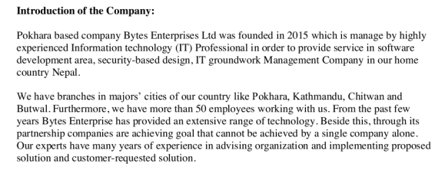

INTRODUCTION

Slide 5
PROBLEM AND PURPOSED SOLUTION
PROBLEM AND CAUSES
TIME CONSUMING
COMPLICATION IN HANDLING
ECONOMIC BURDEN
TRANSACTION ERROR
TIME CLASH
DATA INSECURITY
BUSINESS ANALYSIS
THEIR SOLUTION
1. CENTRALIZED DATABASE
2. ONLINE MODES
3. DIGITAL PAYMENT

Slide 6
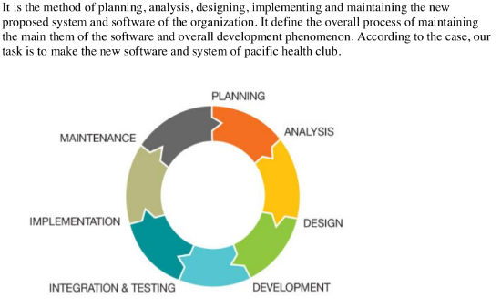
SYSTEM DEVELOPMENT LIFE CYCLE
PLANNING STAGE
ANALYSIS
DESIGN
IMPLEMENT STAGE
MANAGEMENT AND SUPPORT

Slide 7
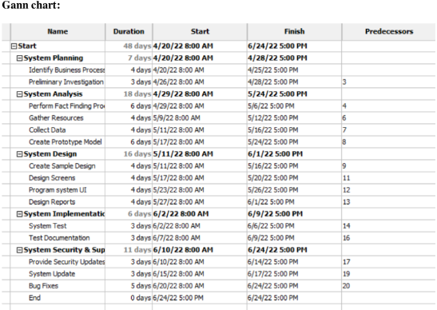
GANTT CHART

Slide 8
FESIBILITY STUDY
A feasibility study is an assessment of the practicality of a proposed plan or project. A feasibility study analyzes the viability of a project to determine whether the project or venture is likely to succeed.
SCHEDULED TIMETABLE
COST ALLOCATION
TECHNICAL AVAILABILITY
OPERATIONAL FEASIBILITY
PIECES FRAMEWORK
P(PEROFOMANCE)
I(INFORMATION)
E(ECONOMIC)
C(CONTROL
E(EFFICIENCY)
S(SERVICE)

Slide 9
System analysis
Functional requirement
Defines functions of a system or its components.
Registeration for the new users and login for the old users.
System should be able to update classes on a frequent basis.
User should update their personal informational via the proposed system.
Customer feedback.
Non functional requirement
The software shall really have a minimal amount of data redundancy.
Transaction must be safeguard, according to the system.
Under excessive load the system really shouldn’t crash.
Data redundancy should be avoided and minimized in the system.

Slide 10
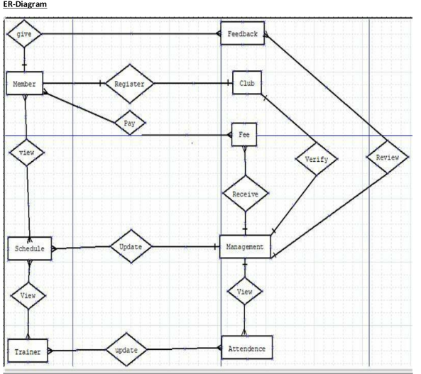
ER DIAGRAM

Slide 11
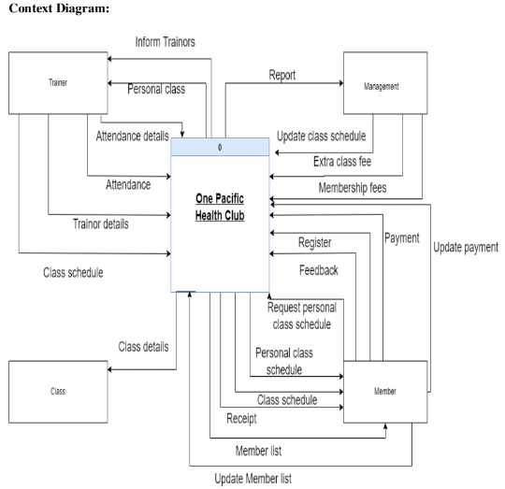
CONTEXT DIAGRAM

Slide 12
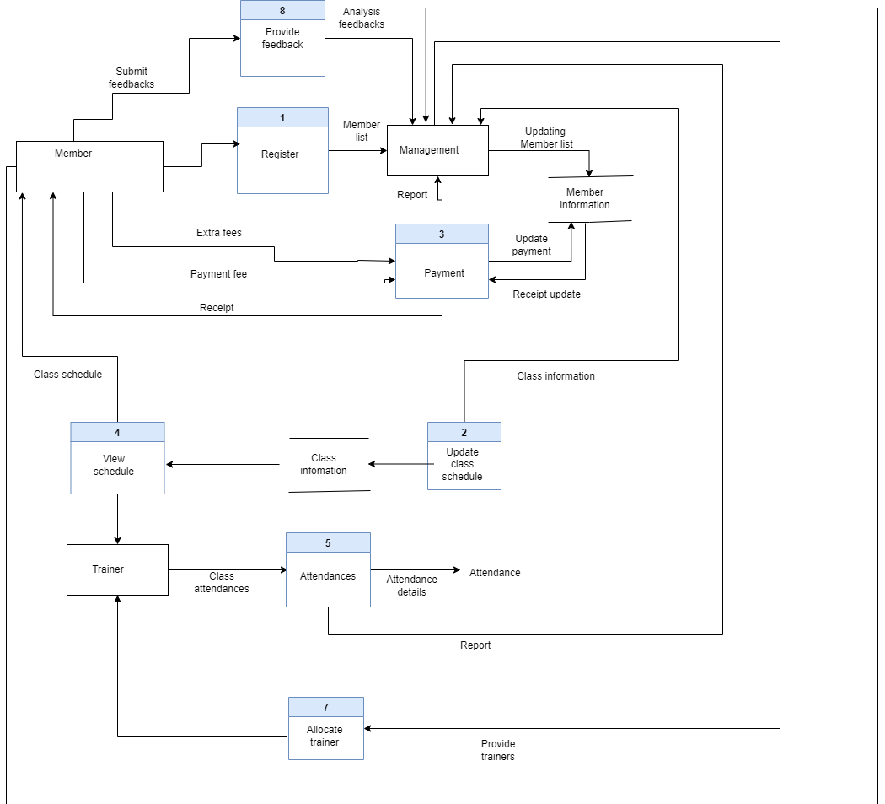
LEVEL ZERO DATA FLOW DIAGRAM

Slide 13
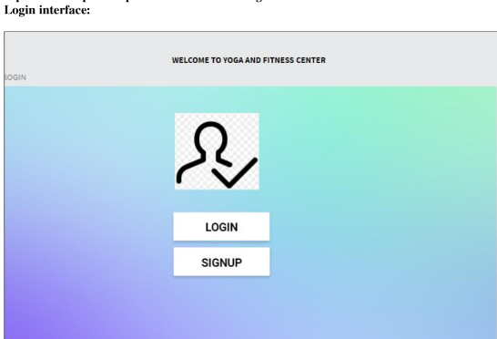

GRAPHICAL USER INTERFACE

Slide 14

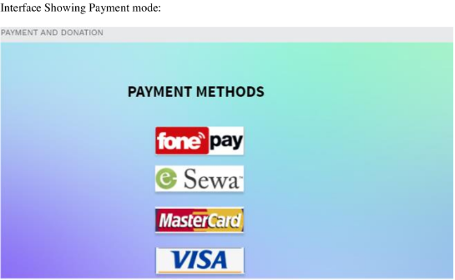

Slide 15
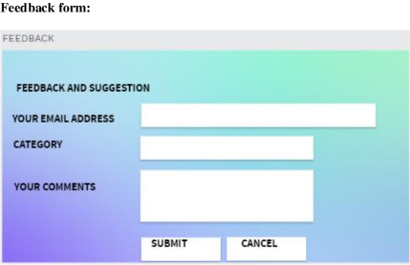
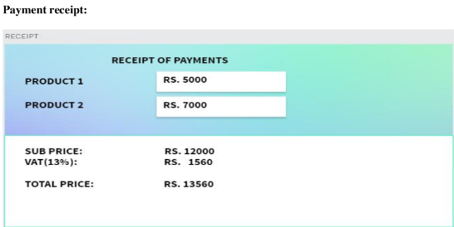

Slide 16
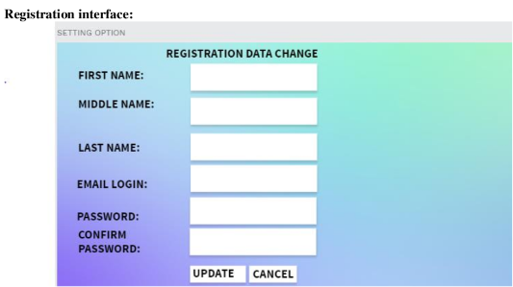
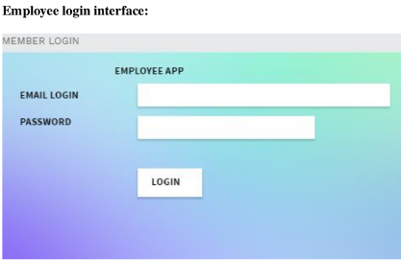

Slide 17
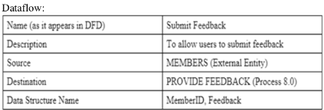
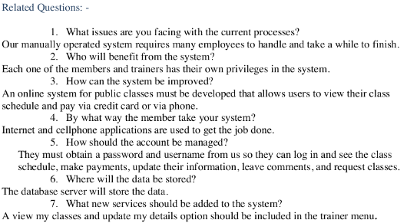
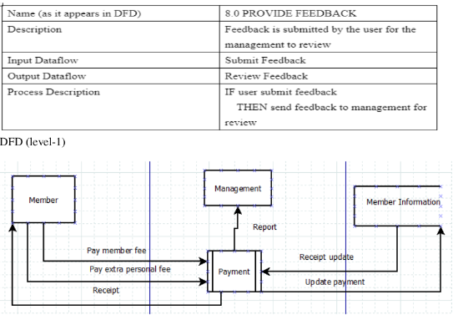
INDIVIDUAL PART
INTERVIEW BY ANKIT ACHARYA
DATA DICTIONARY

Slide 18
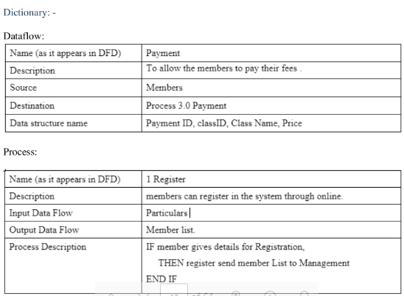
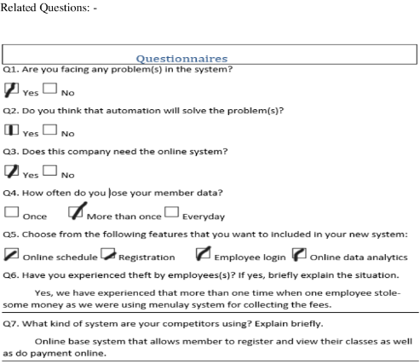
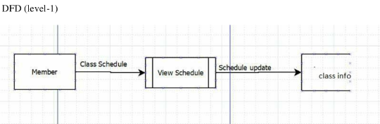
QUESTIONNARIE BY JITEN CHAPAGAIN
DATA DICTNONARY

Slide 19
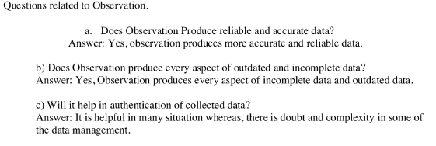
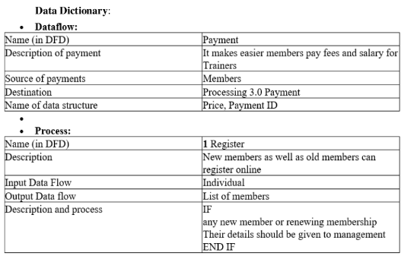
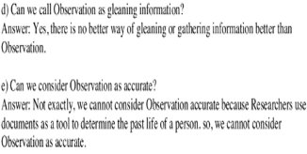
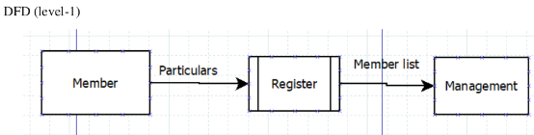
OBSERVATION BY ANMOL MALLA THAKURII

Slide 20
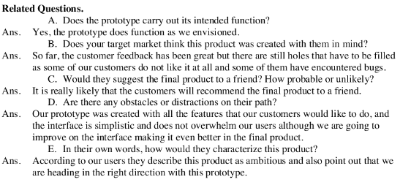
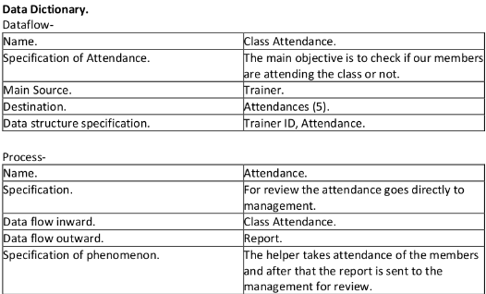
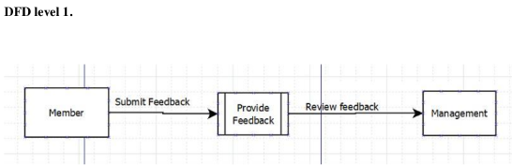
PROTOTYPING BY SATINDRA KHADKA

Slide 21
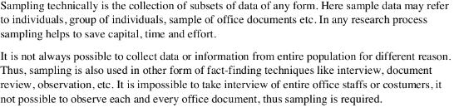
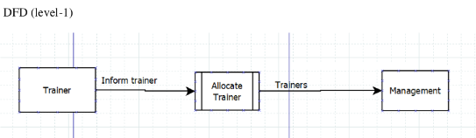
SAMPLING BY RANGIN BASNET
SAMPLING TECHNIQUE
SIMPLE RANDOM SAMPLING
STARTIFIED RANDOM SAMPLING
CLUSTER RANDOM SAMPLING
SYSTEMATIC RANDOM SAMPLING

Slide 22
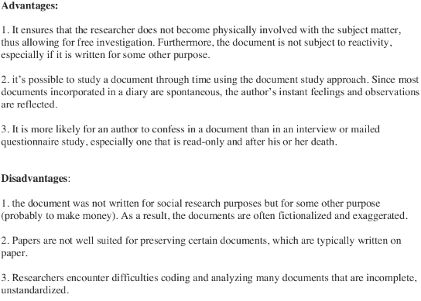
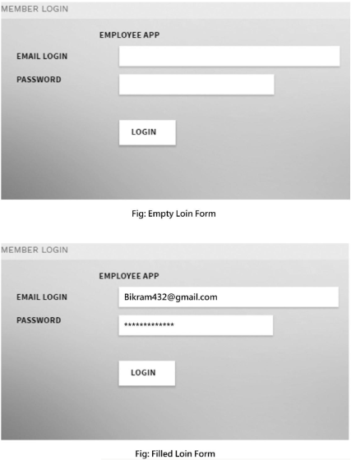
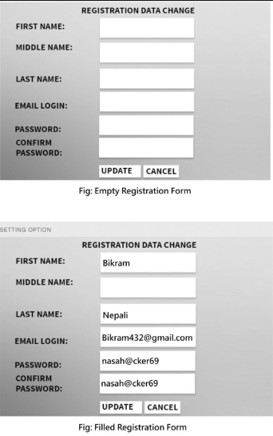
DOCUMENT REVIEW BY PUKAR NEPALI

Slide 23
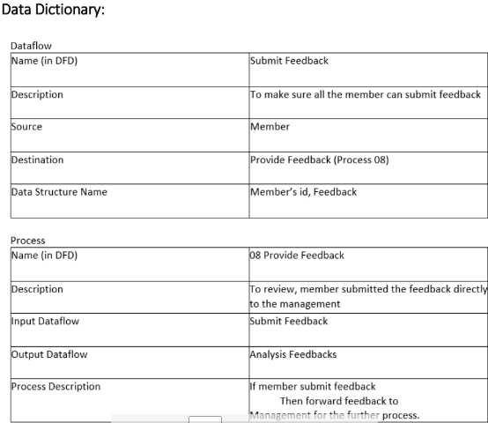
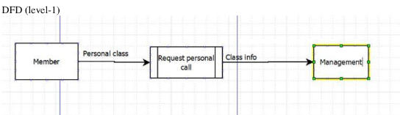
DOCUMENT REVIEW BY PUKAR NEPALI
DATA DICTIONARY

Slide 24
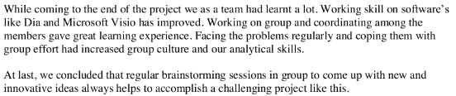
CONCLUSION

Slide 25
Any Question?

Slide 26
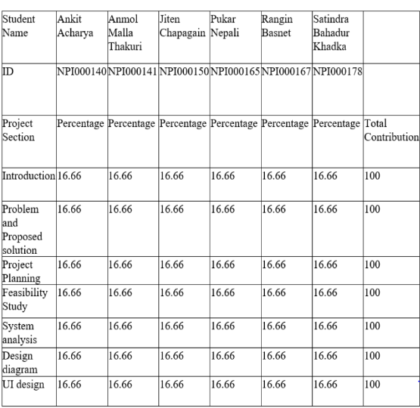
GROUP WORKLOAD MATRIX

Slide 27
INDIVIDUAL WORK LOAD MATRIX
Name | Topic | Workload
Ankit Acharya | Interview | 100%
Jiten Chapagain | Questionnarie | 100%
Anmol Malla | Observation | 100%
Satindra Khadka | Prototyping | 100%
Rangin Basnet | Sampling | 100%
Pukar Nepali | Document Review | 100%

